Slide 1
Fourth Year Project
Robert Gabriel

Slide 2
Enhancing sentence understanding by using machine learning algorithms and natural language algorithms aka a poor man's Google.

Slide 3
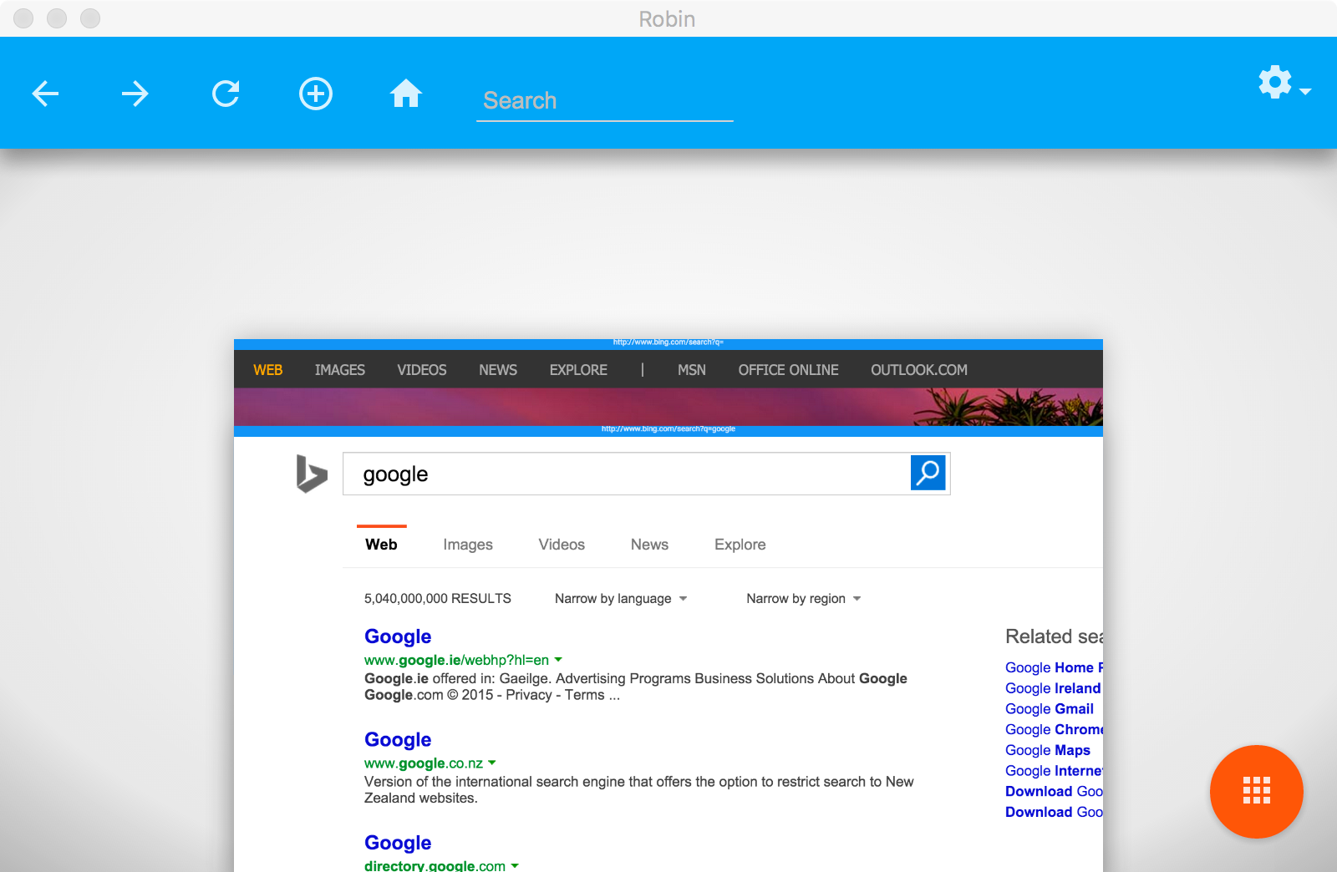

Web browser
&
Filtering Tools

Slide 4
Understanding Sentences using Algorithms

Slide 5
The Problem
A Lot of Filtering software give false positives.
They block both Porn websites and sex educational websites.
I aim to help solve this.
Work Cross platform

Slide 6

Firebase
Autoscaling built-in
Robust APIs for Javascript (including several frameworks like Angular), iOS, and Android
Built-in authentication services like Facebook
Declarative Security Rules model allows us to enforce read/write privileges and data validation throughout the tree

Slide 7
Firebase : Cons
Need to build indexes manually
Implementation of REST API could be difficult on embedded platforms
Data validation rules do not support complex objects directly (you'd need to validate individual child nodes separately)

Slide 8

Node.js
Built to handle Asynchronous I/O
Javascript
Speed! (Performance)
Node.js is event-driven and non-blocking and very good a

Slide 9

Node webkit
Cross platform windows and mac
Easy to use
Takes advantages of Package.json
Gulp.js
Low memory usage

Slide 10










Other Tools

Slide 11
MrScraper Module
Reads a website and takes all texts.
Stores in an array.
Works with the Profanity Module
Code
var mrscraper = require("./mrscraper.js"); var chalk = require('chalk');
mrscraper("http://www.tested.com", function (response) { console.log(chalk.blue(response)); });

Slide 12
Profanity Algorithm
It use the mr Scraper module.
To Check if a word is a verb or classed as Profanity
Stores online in firebase
Builds a better picture of the sentence
Key rule based algorithm
Learning to learn
var profanity = require("./profanity.js"); var chalk = require('chalk'); profanity("sex", function (response) { if (response === "false") { console.log(chalk.blue(response)); } else { console.log(chalk.red(response)); } });

Slide 13




Who's it for ?
Parents
Children
Teachers
Anyone Supervising

Slide 14



Refresh page
Create new tab
View tabs
Go Forward
Go Back
Go Home
Search the web
Change the theme
Web browser

Slide 15

Set Blacklist sites
Set Whitelist Sites
​Personal settings
See what your children are on.
Alert you when your child goes on banned site.
Set time limits on on the use of the browser
Chrome Extension

Slide 16
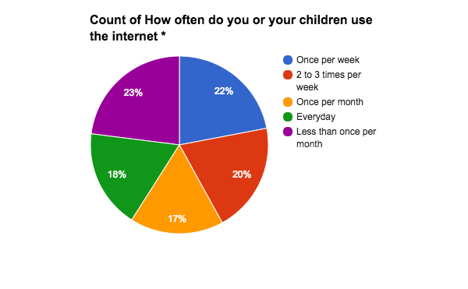
Evaluation Methods
Focus groups
Wireframe testing
First click testing
Usability testing
Satisfaction surveys

Slide 17
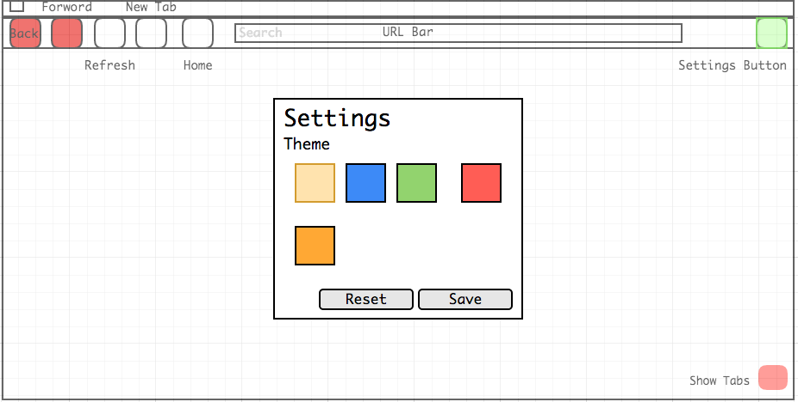
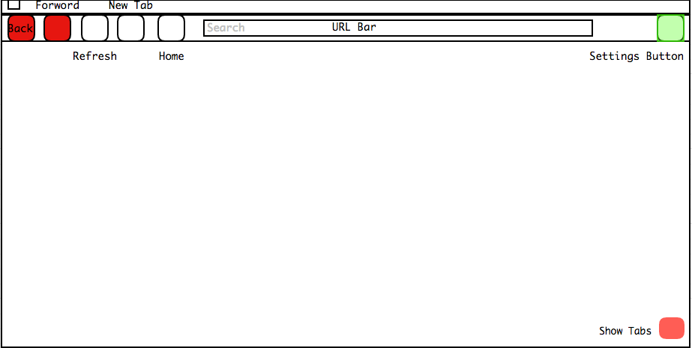
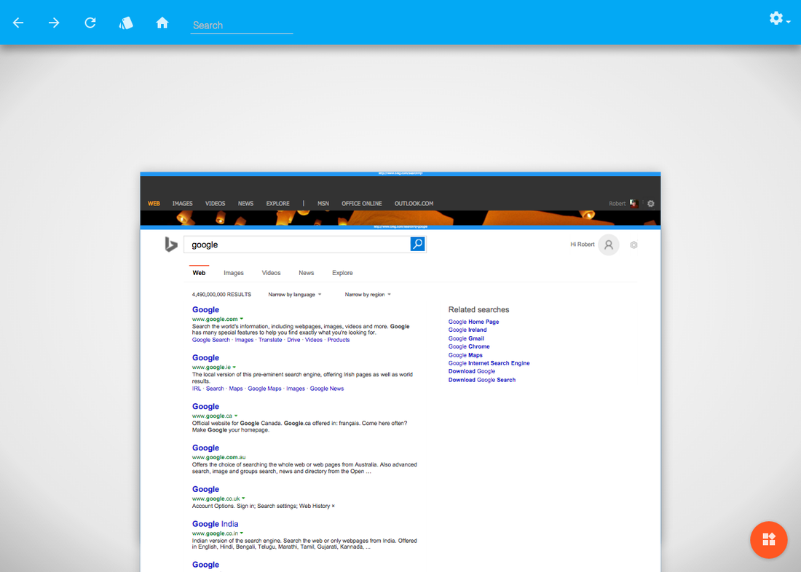
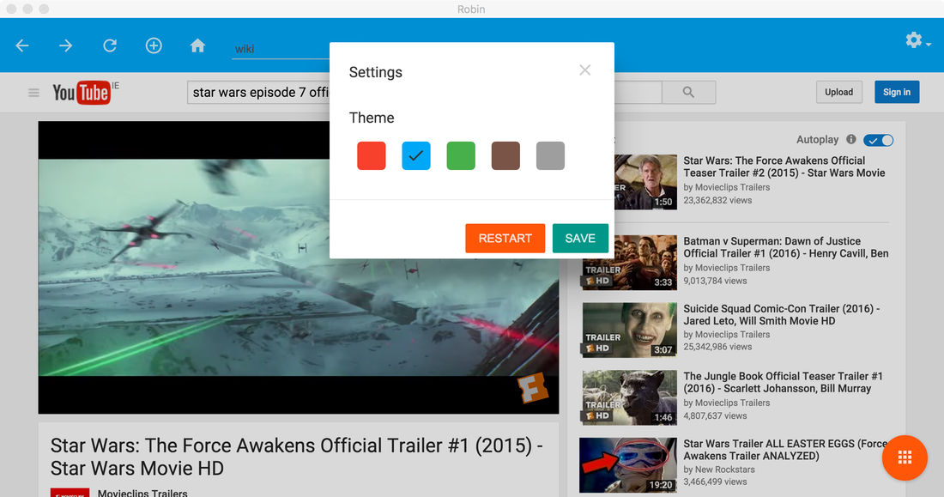
Robin Browser

Slide 18
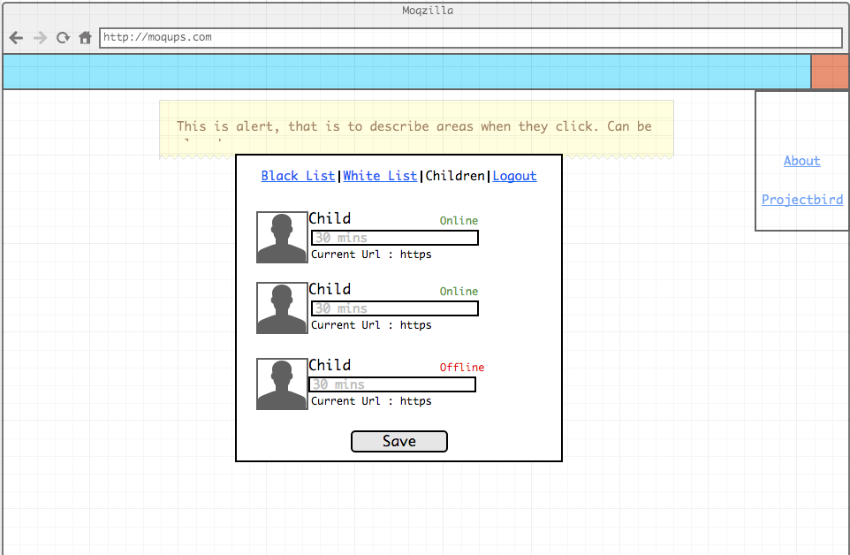
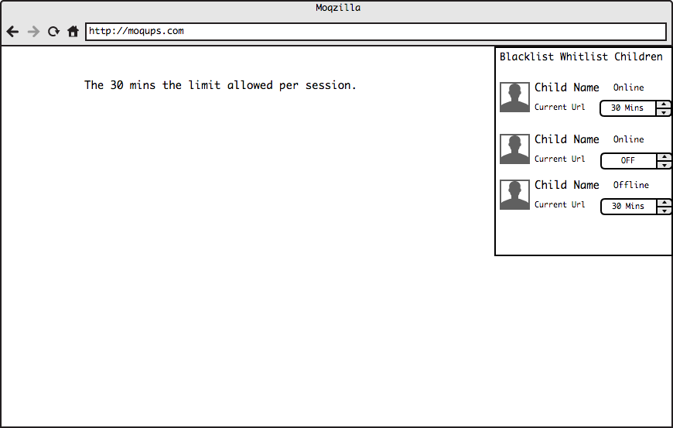
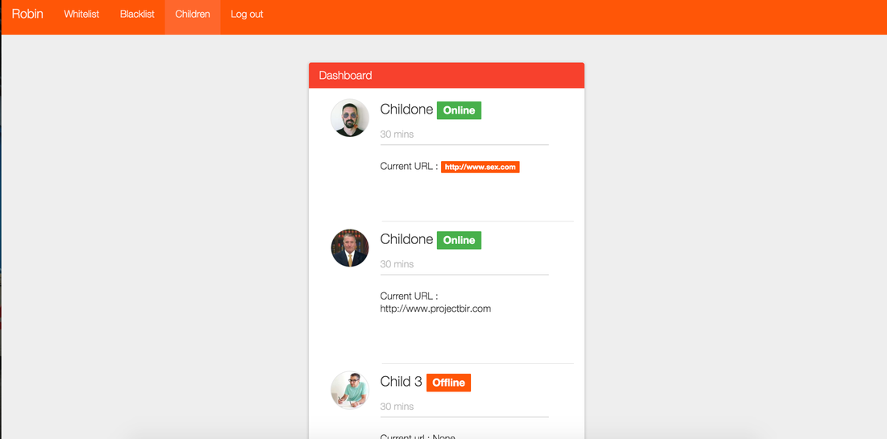
Chrome Extension

Slide 19
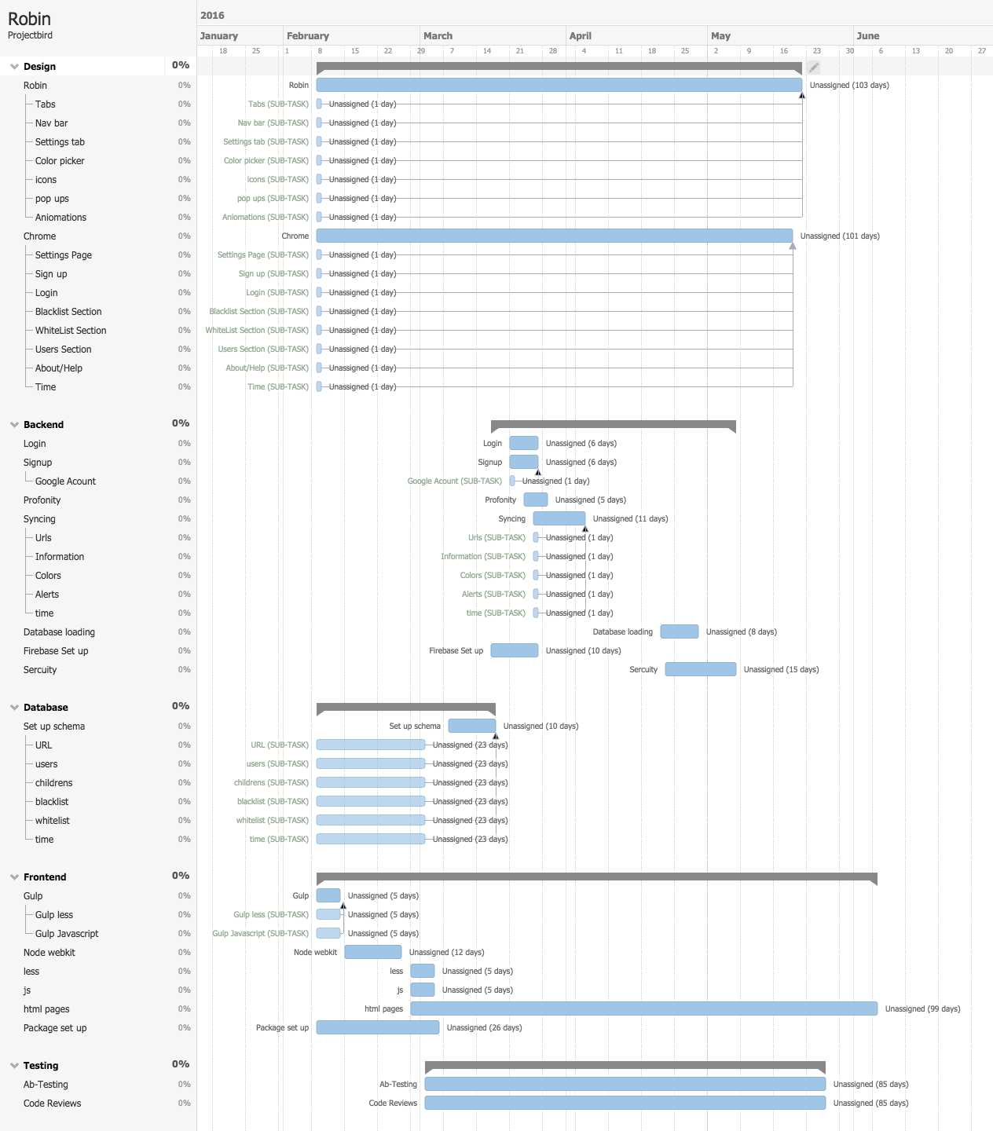
Plan
Start february 1st
Finish may 1st
40 - 60 hours of work.

Slide 20
Thank you

